Slide 1


Cash Management Operations and Reporting in Oracle ERP
NXT35_ALX2_ERP4_G1
Management and ERP
Oracle Digital Accounting Specialist

Slide 2

Bassem Reda Sadek Mohamed
Zeyad Mohamed Yassin
Mazen Mohamed Mahmoud
Mahmoud Salah Mohamed
Group Members
Mohamed Ahmed Refay

Slide 3

Quick introduction to Cash Management in Oracle ERP.
The importance of Cash Management in digital accounting.

Slide 4
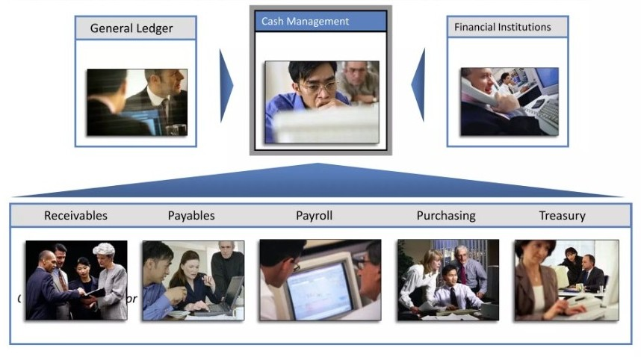
Oracle cash management is an enterprise-wide solution for managing liquidity and controlling cash

Slide 5
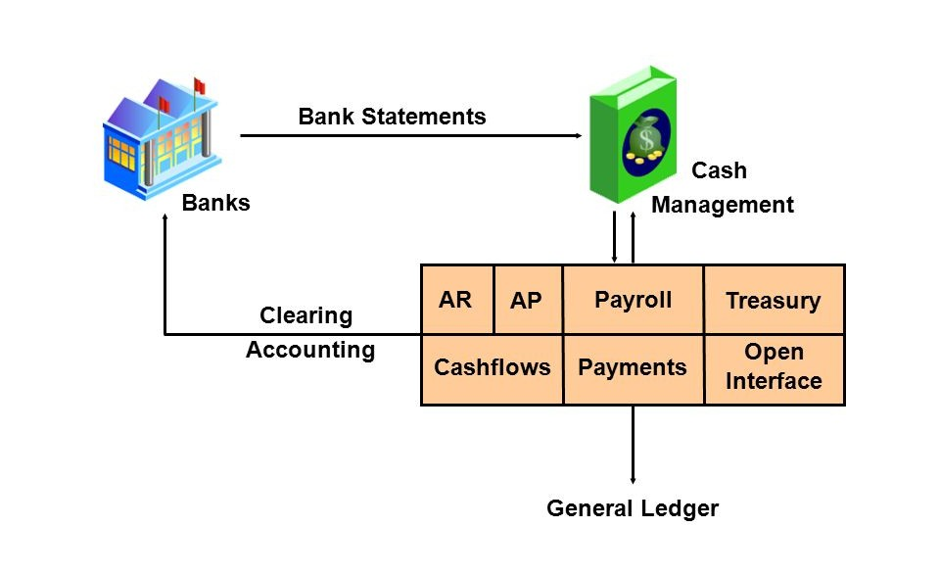
Cash management integration

Slide 6
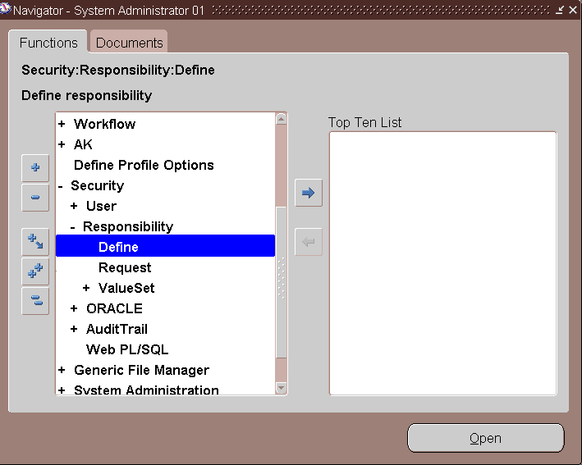
Define Responsibility
1
Before we can use any module in Oracle we need to define a Responsibility
2
3

Slide 7
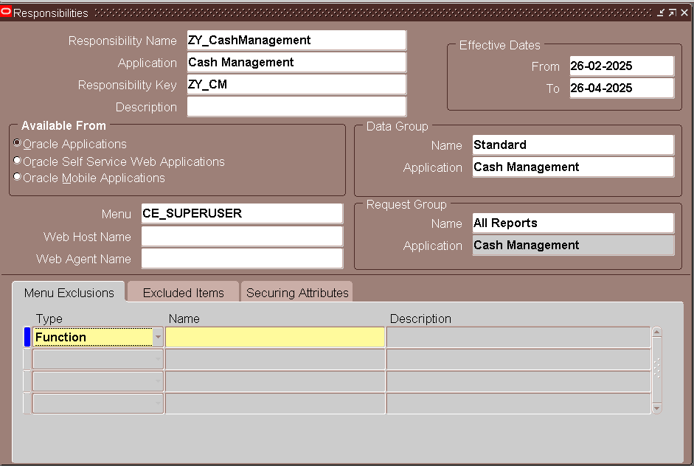
Define Responsibility

Slide 8
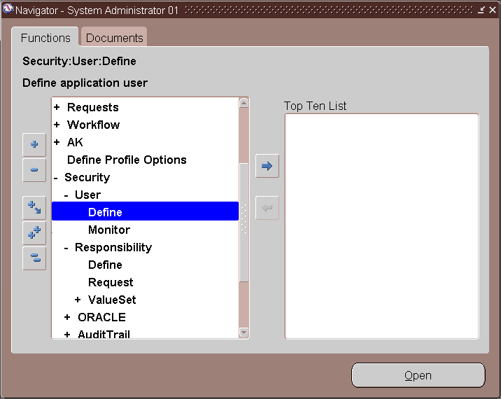
Link the Responsibility to a User
1
Once the responsibility is created, we need to assign it to a user.
2
3
4

Slide 9
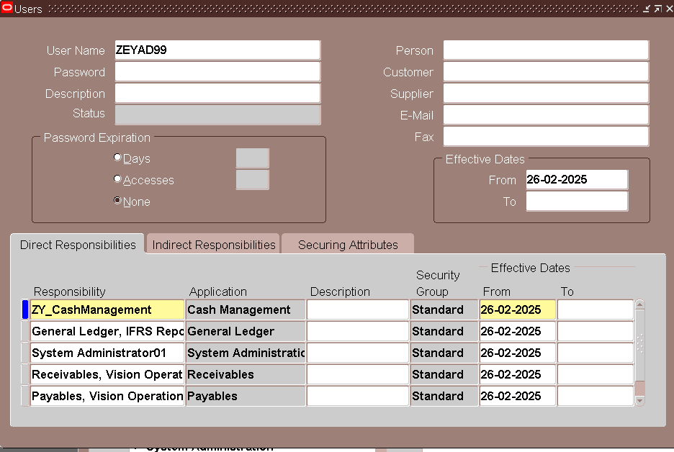
Link the Responsibility to a User

Slide 10
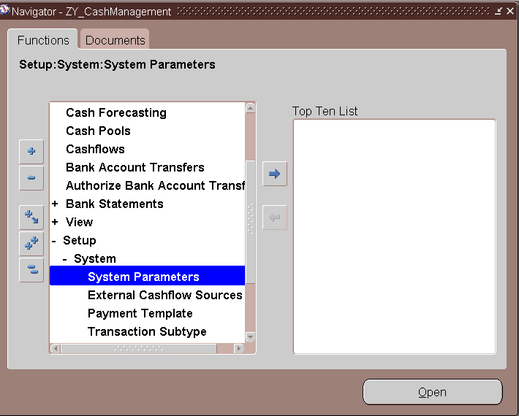
Oracle Cash Management Setup
1
2
3

Slide 11
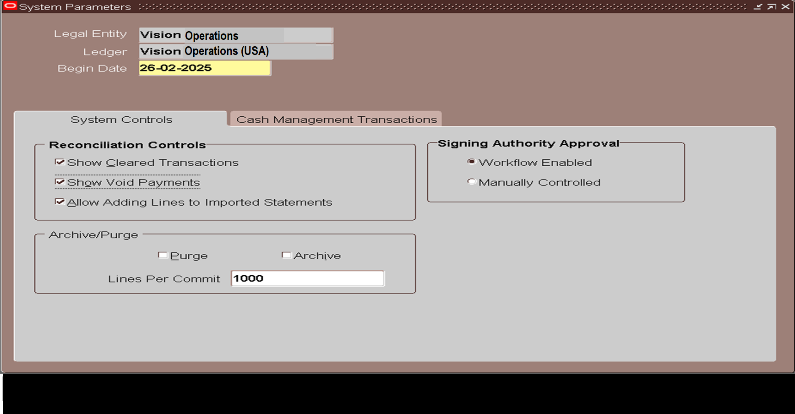
Oracle Cash Management Setup

Slide 12
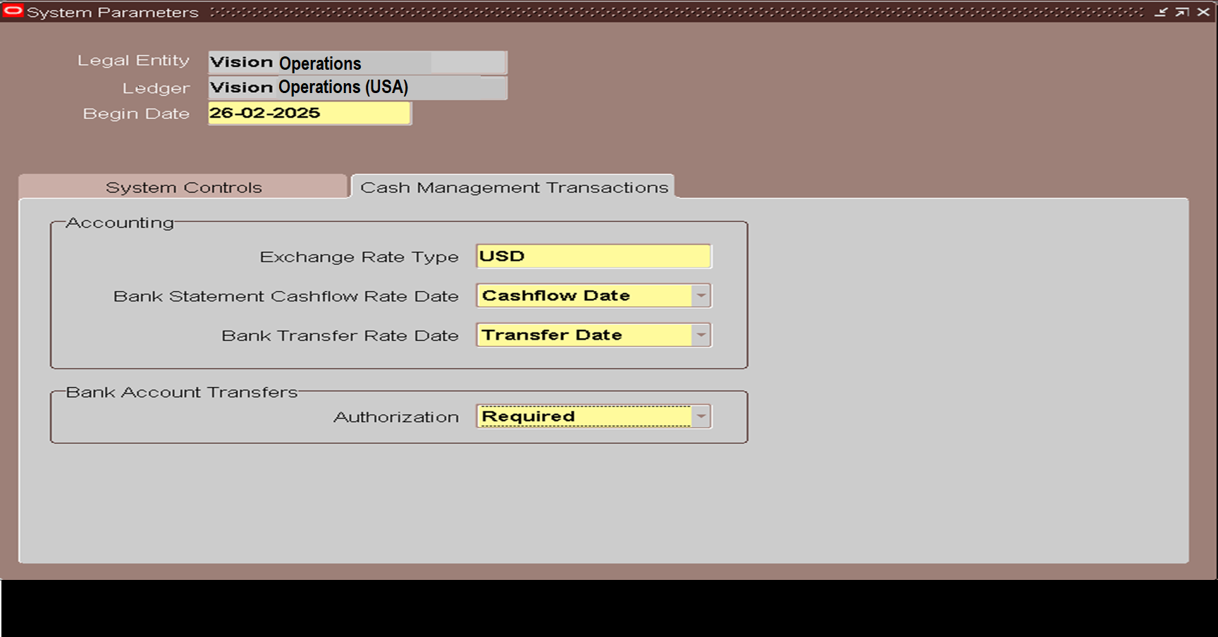
Oracle Cash Management Setup

Slide 13
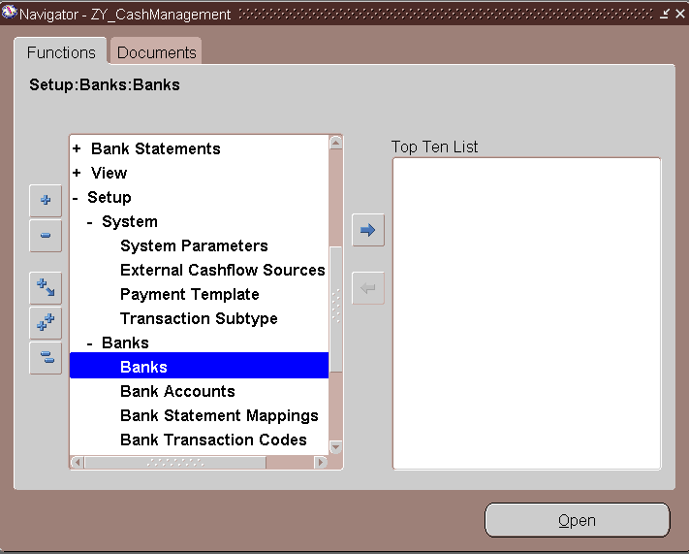
Bank Creation
1
Here we will start to create the bank setup
In three steps:
Bank creation
Bank branch creation
Bank account creation
2
3

Slide 14
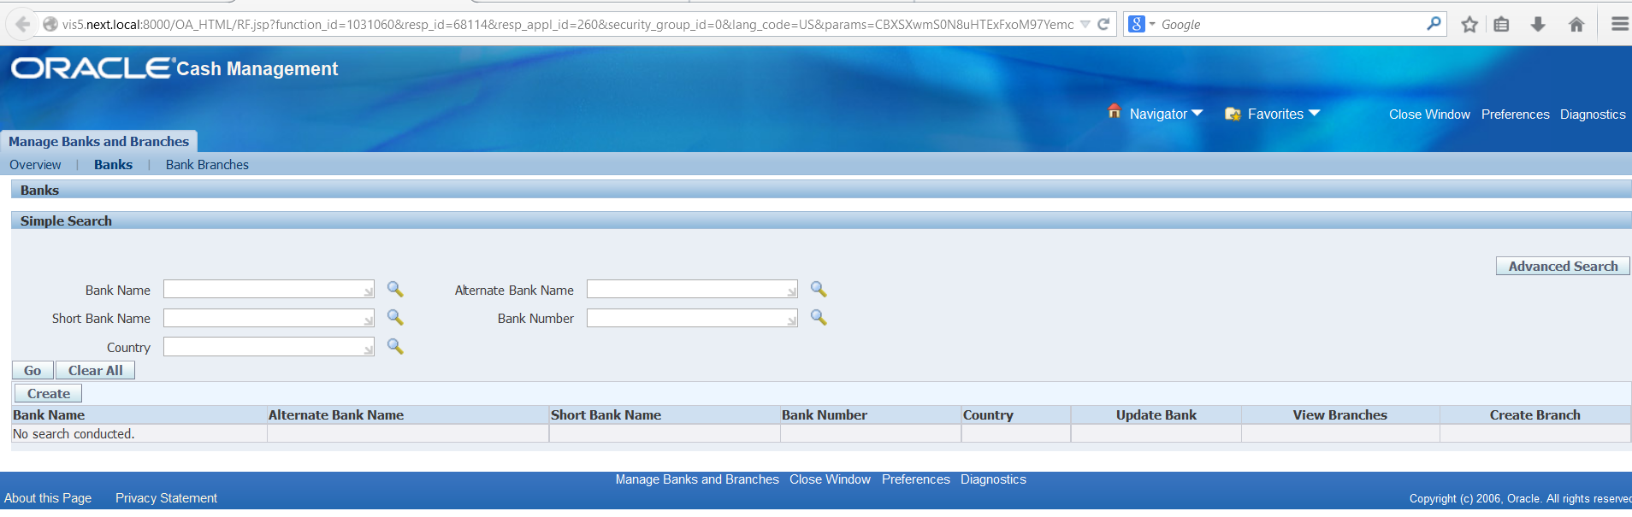
Bank Creation

Slide 15
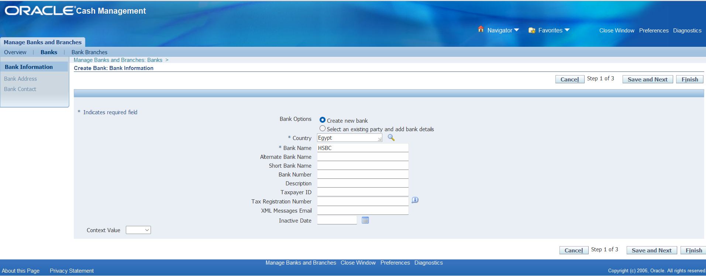
Bank Creation

Slide 16
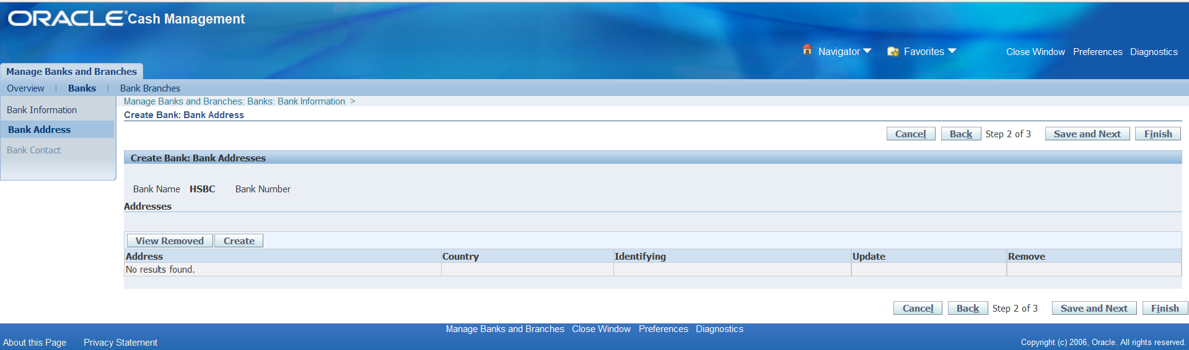
Bank Creation

Slide 17
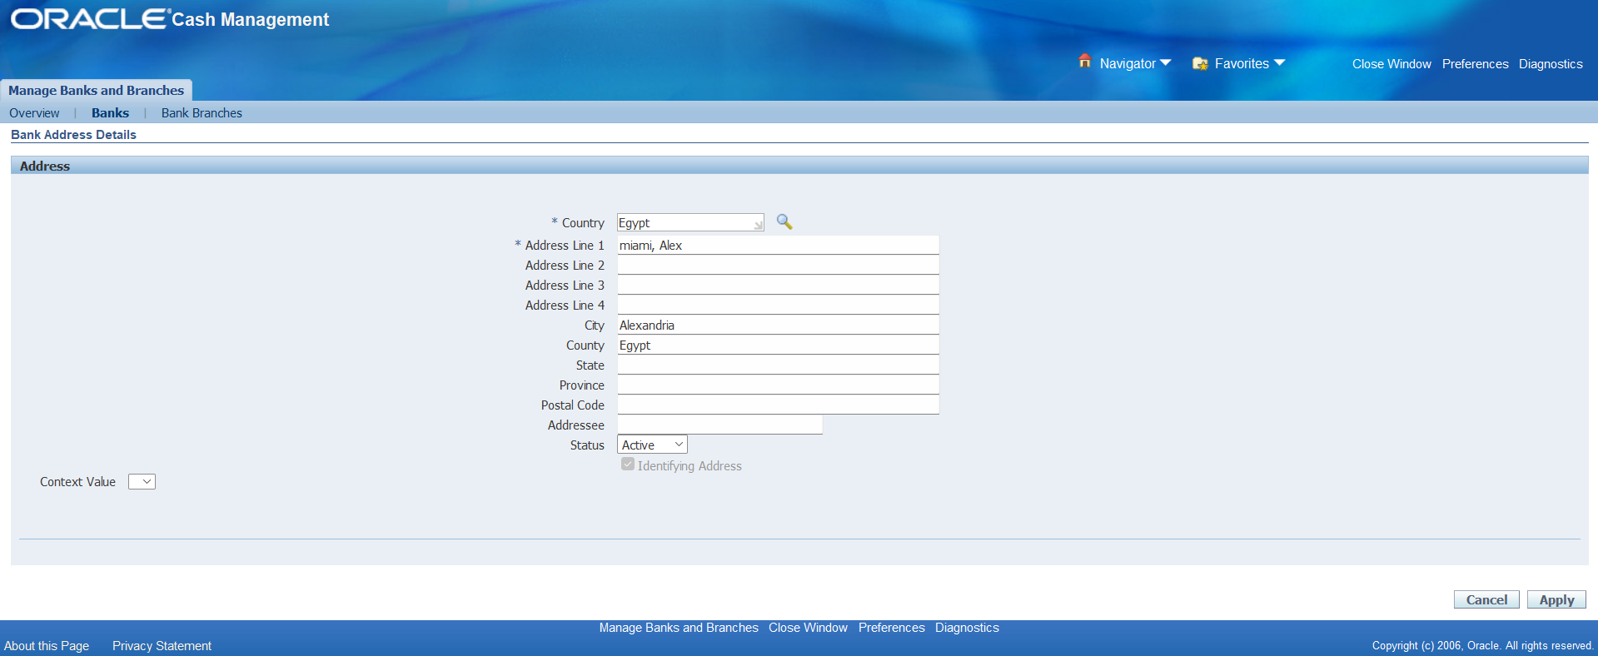
Bank Creation

Slide 18
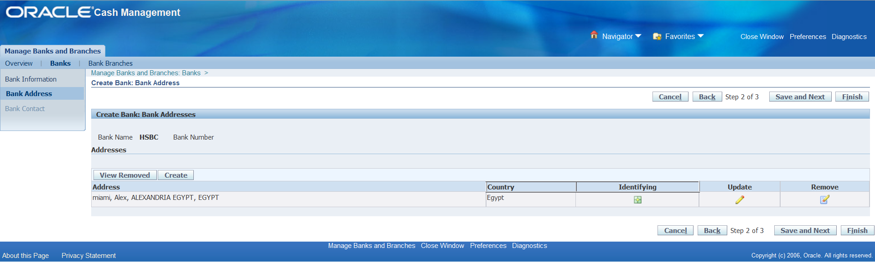
Bank Creation

Slide 19
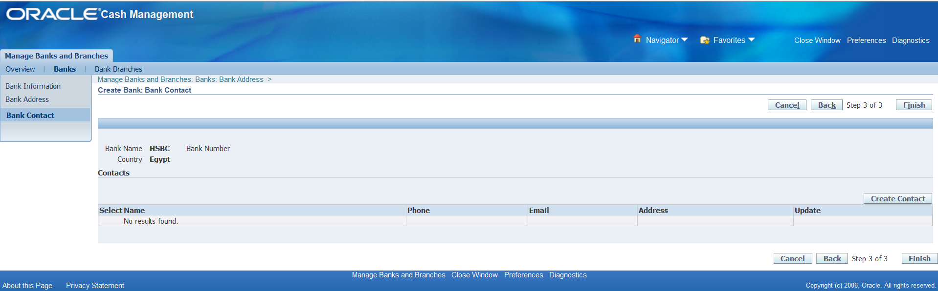
Bank Creation

Slide 20
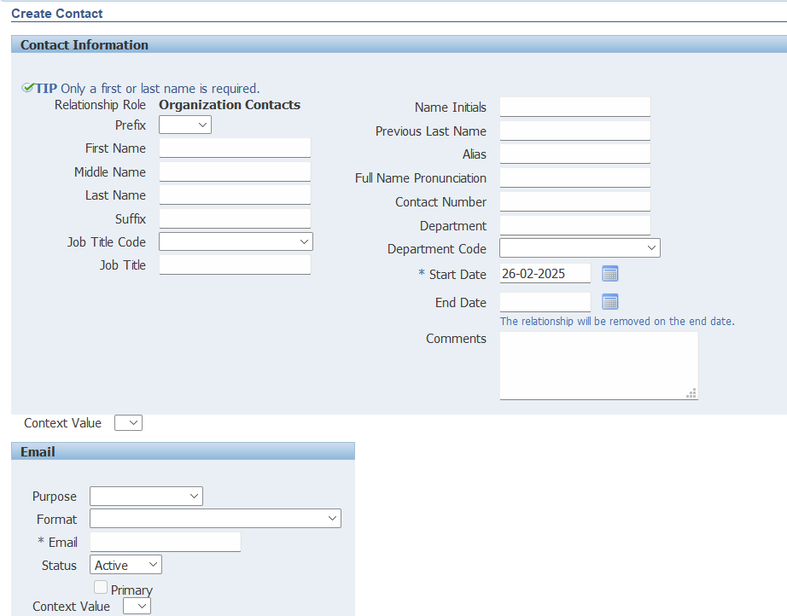
Bank Creation

Slide 21
Bank Creation

Slide 22
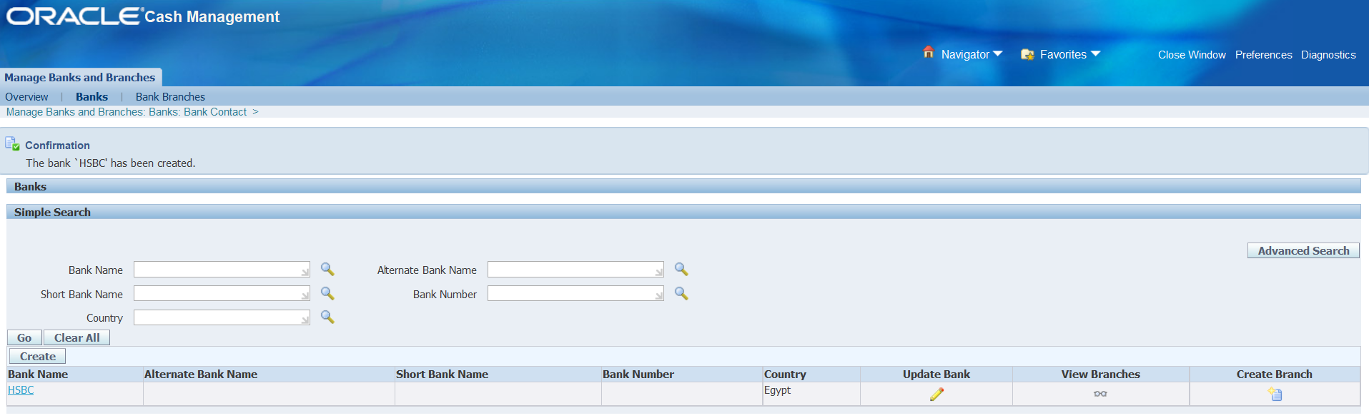
Bank Creation

Slide 23
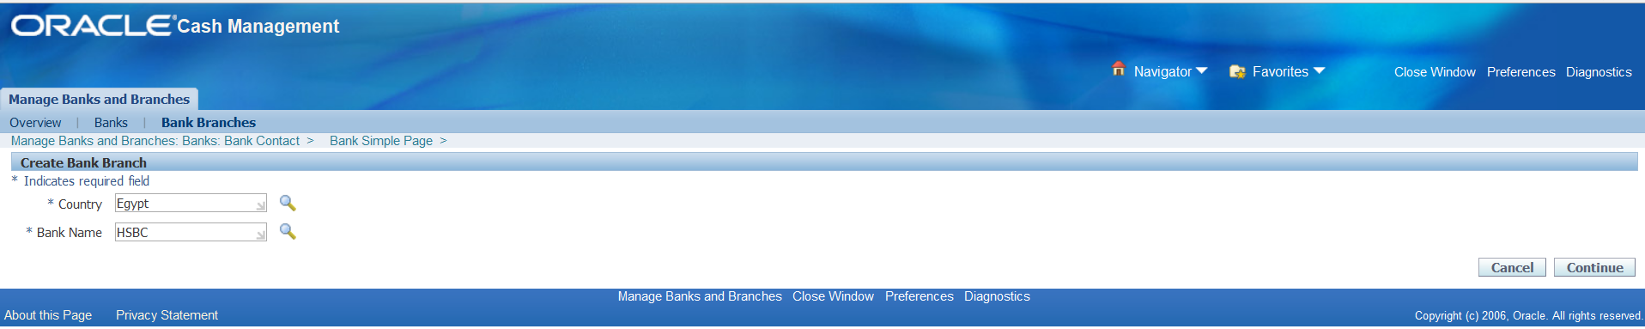
Bank Branches Creation

Slide 24
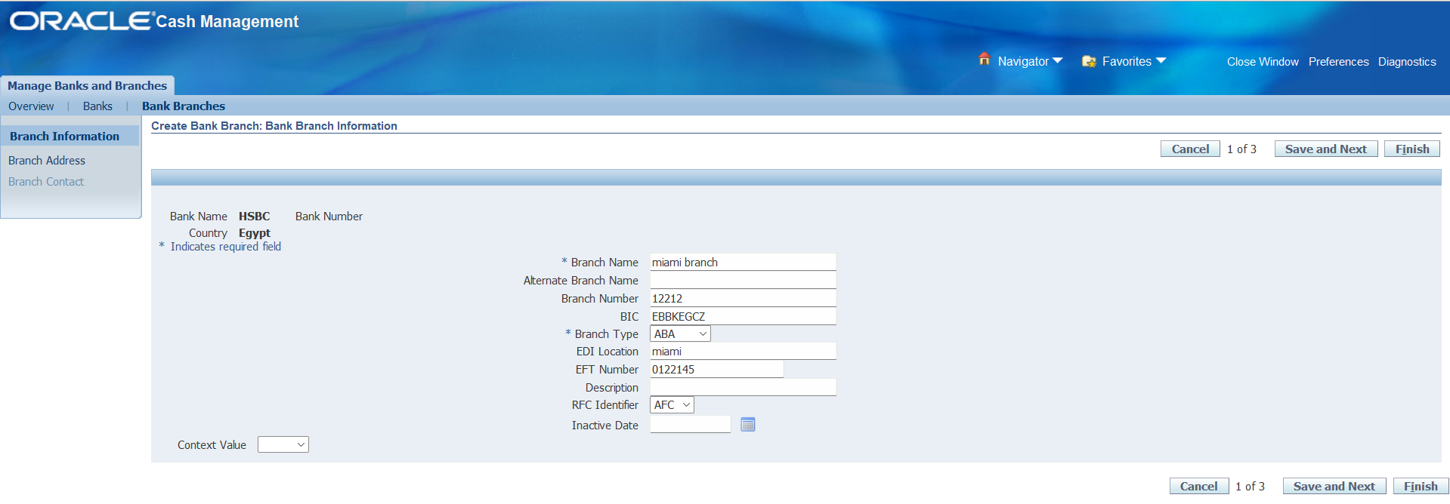
Bank Branches Creation

Slide 25
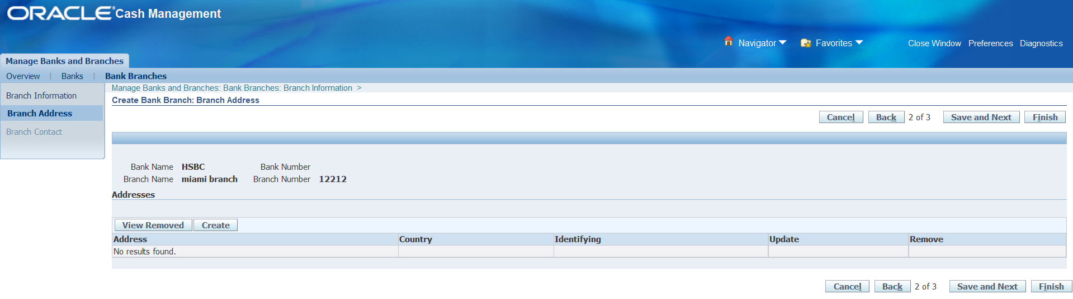
Bank Branches Creation

Slide 26
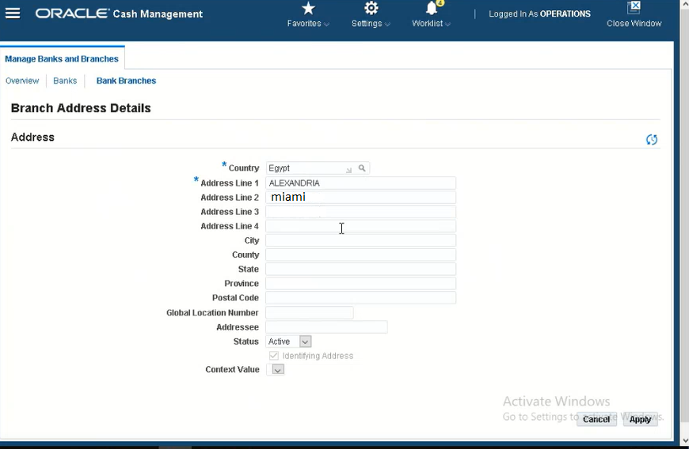
Bank Branches Creation

Slide 27
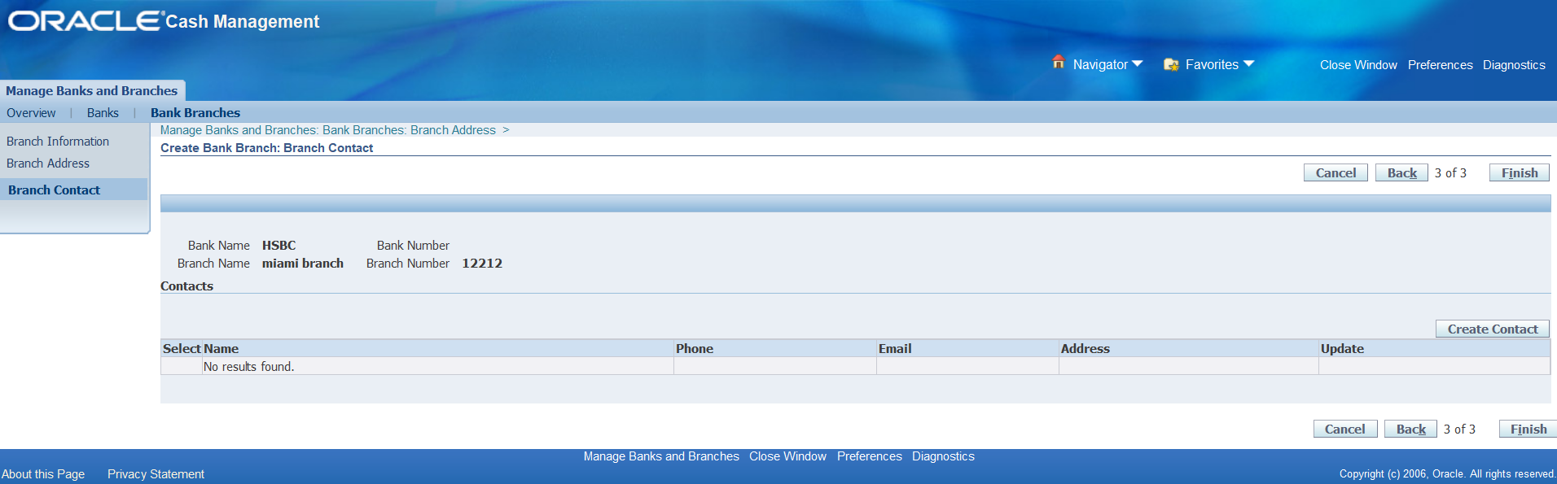
Bank Branches Creation

Slide 28
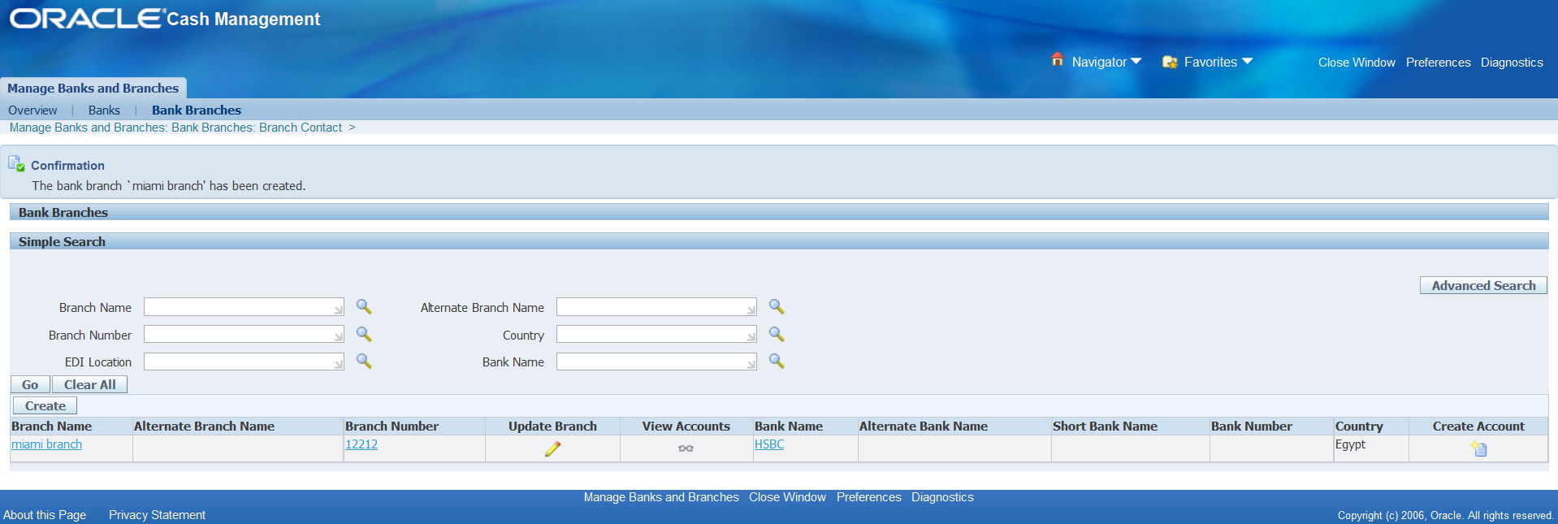
Bank Branches Creation

Slide 29
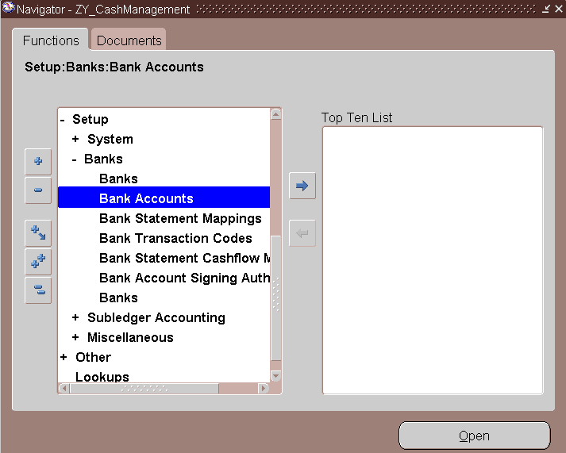
Bank Accounts Creation

Slide 30
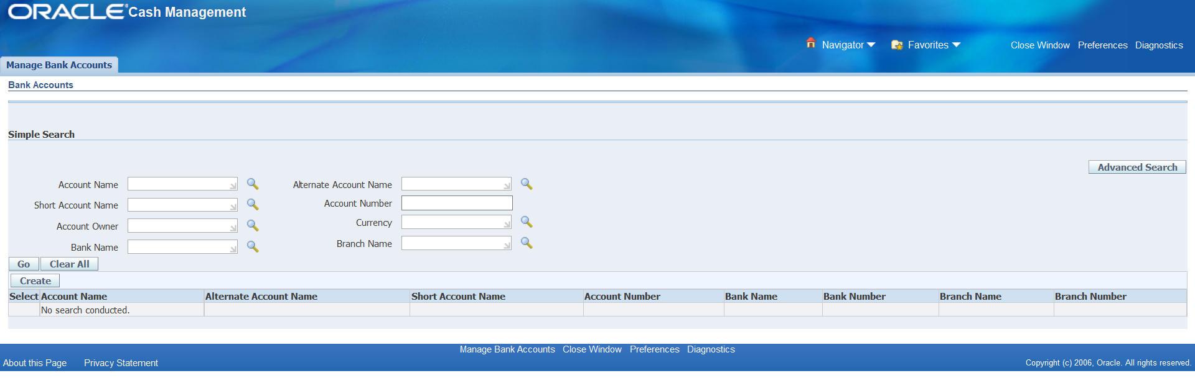
Bank Accounts Creation

Slide 31
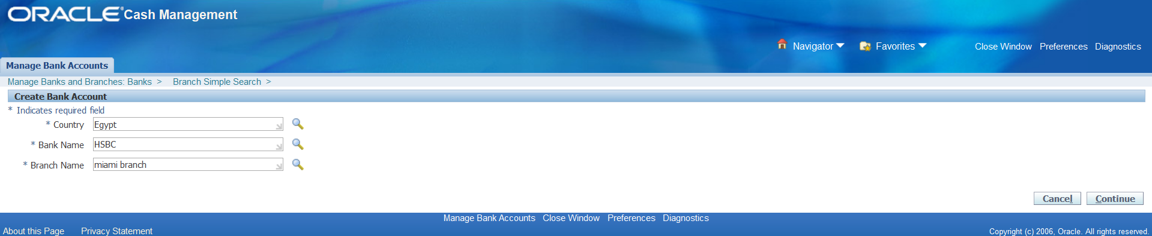
Bank Accounts Creation

Slide 32
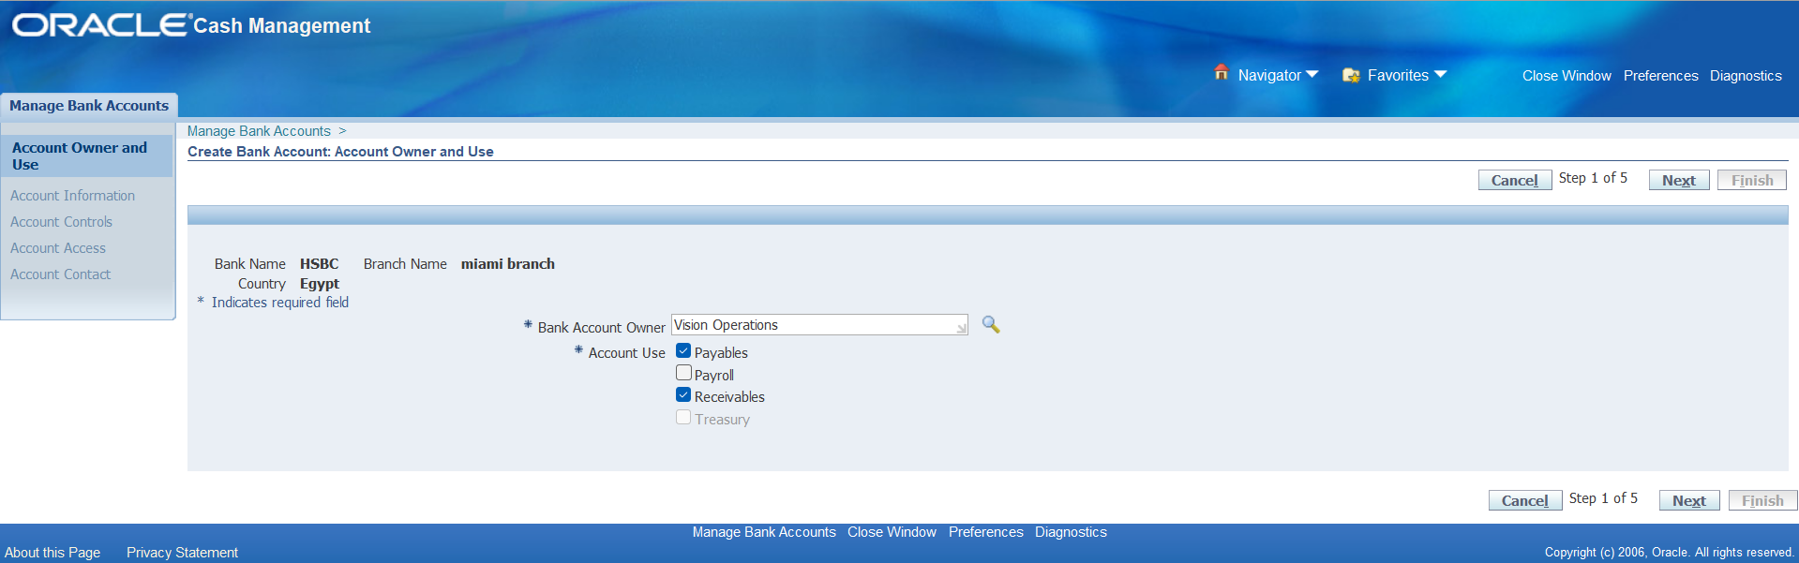
Bank Accounts Creation

Slide 33
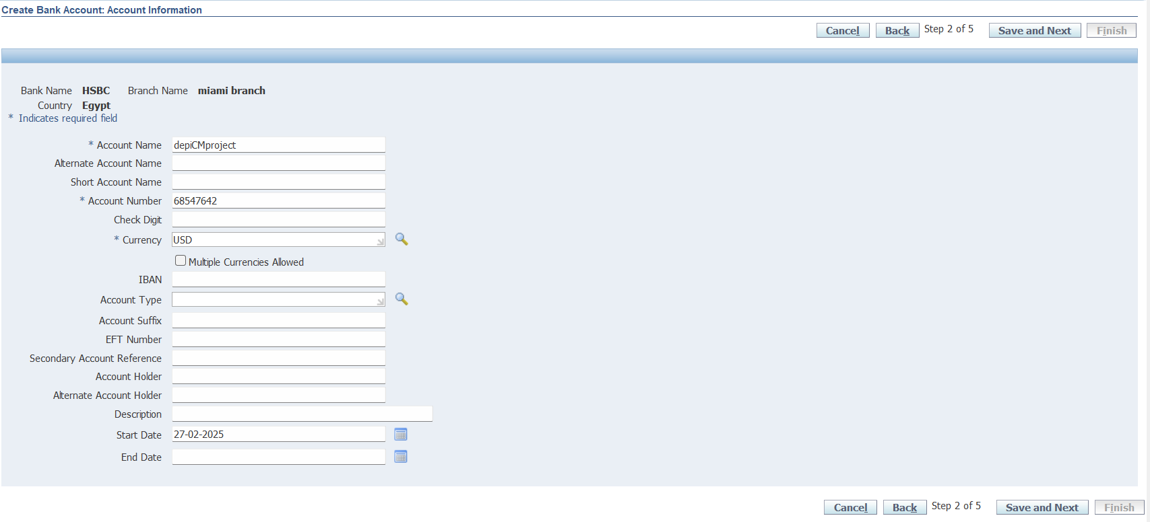
Bank Accounts Creation

Slide 34
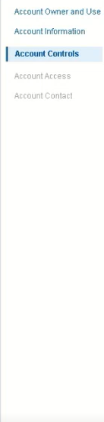
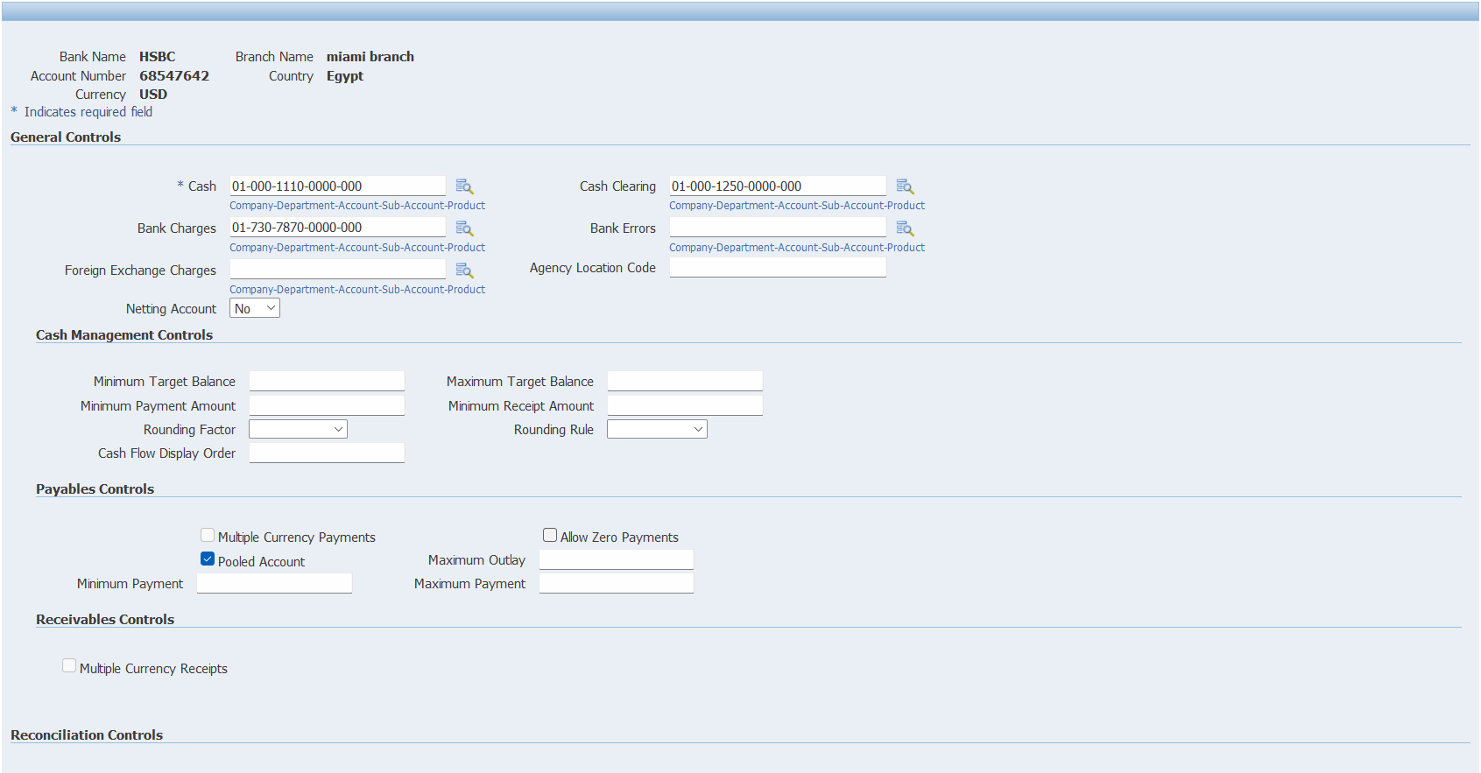
Bank Accounts Creation

Slide 35
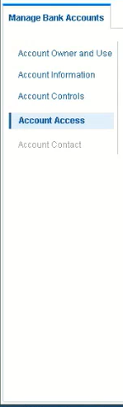
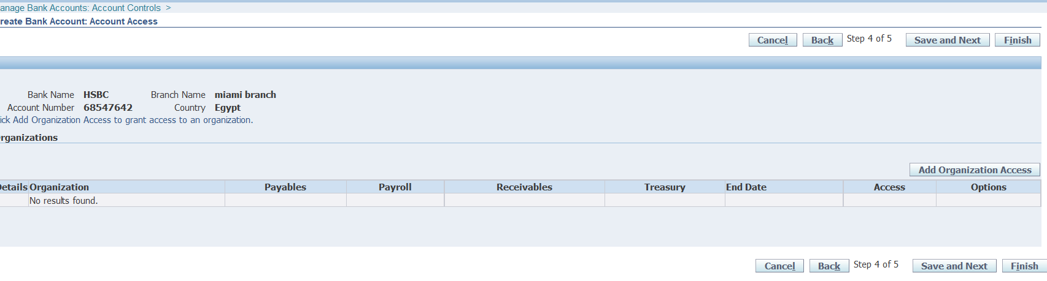
Bank Accounts Creation

Slide 36
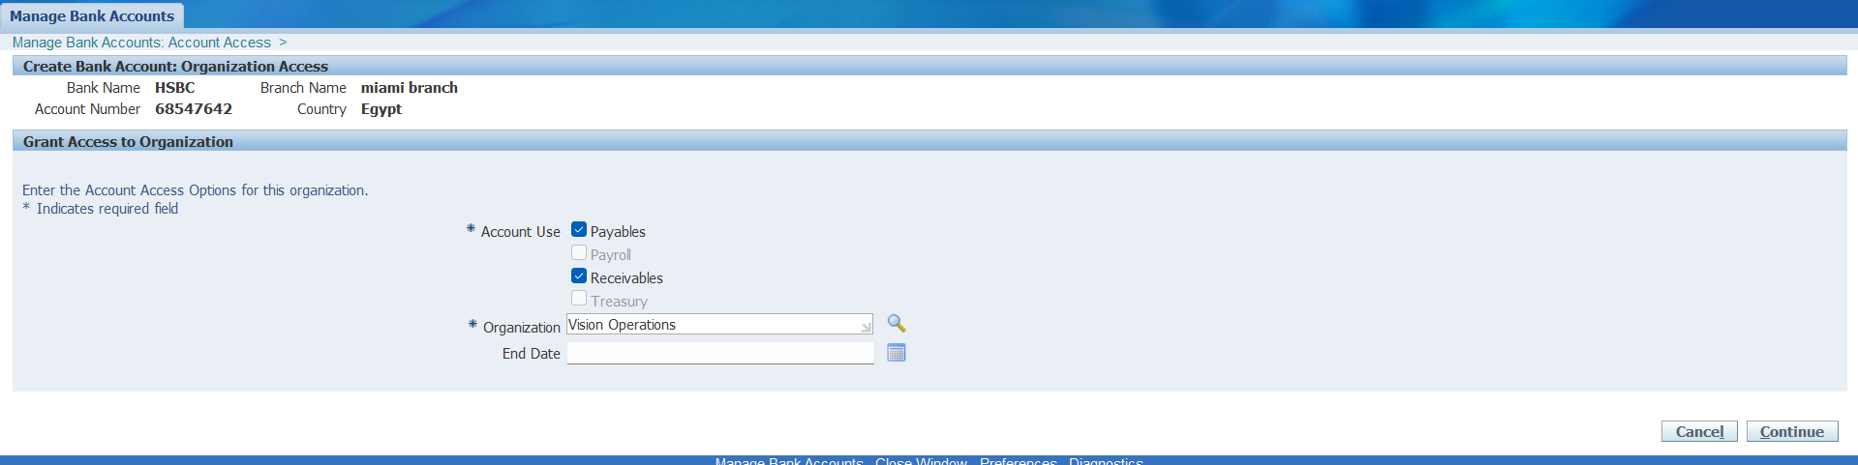
Bank Accounts Creation

Slide 37
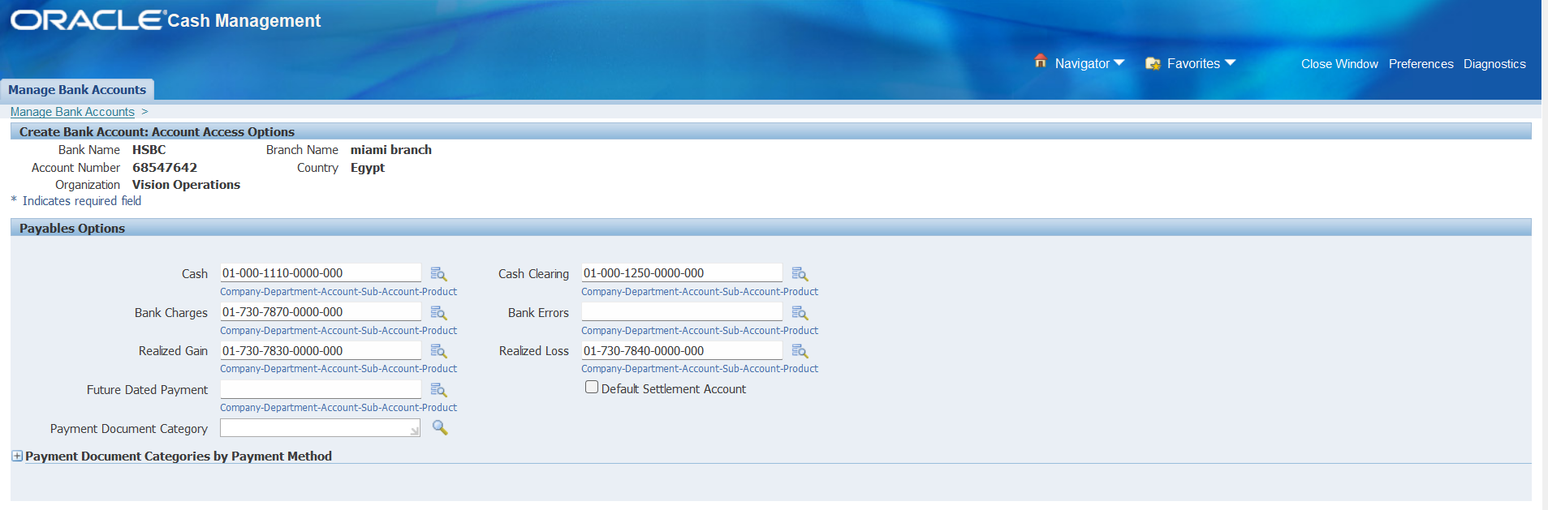
Bank Accounts Creation

Slide 38
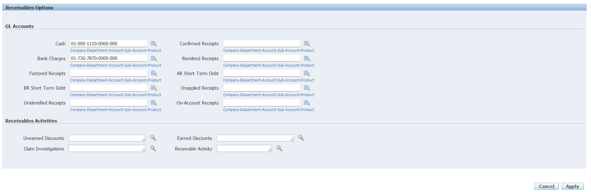
Bank Accounts Creation

Slide 39
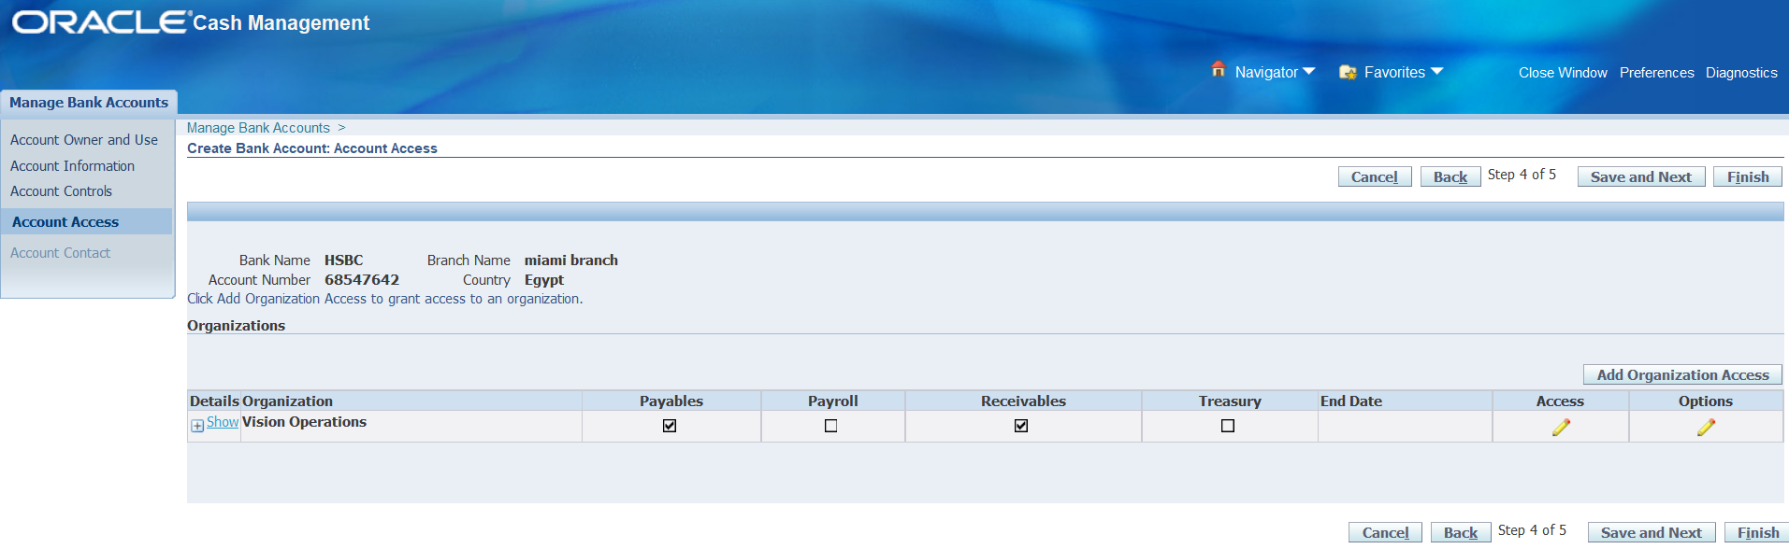
Bank Accounts Creation

Slide 40
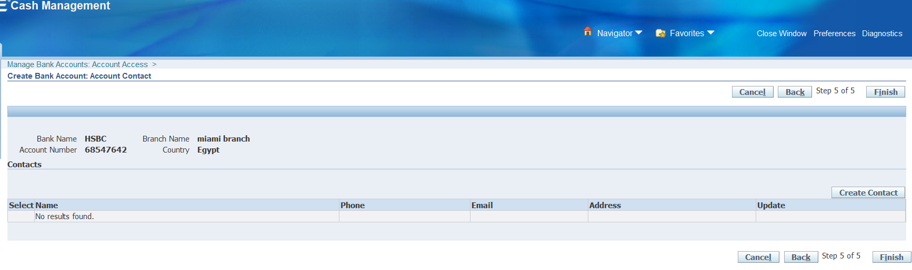
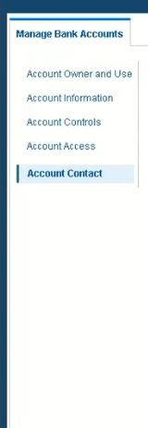
Bank Accounts Creation

Slide 41
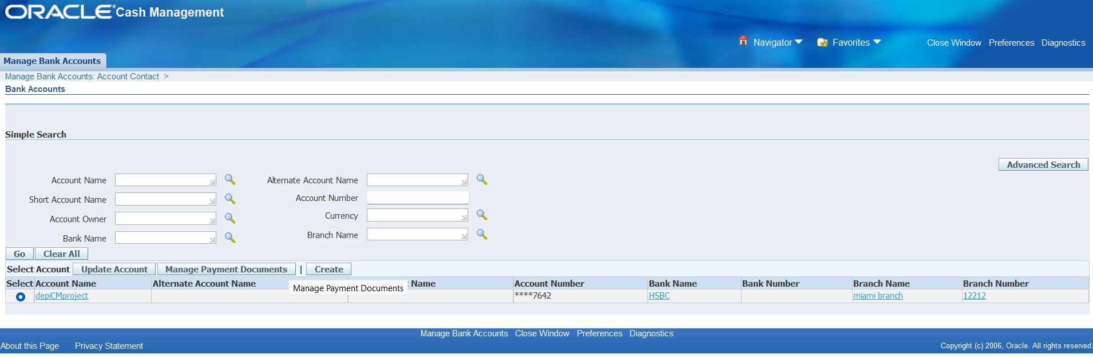
Bank Accounts Creation

Slide 42
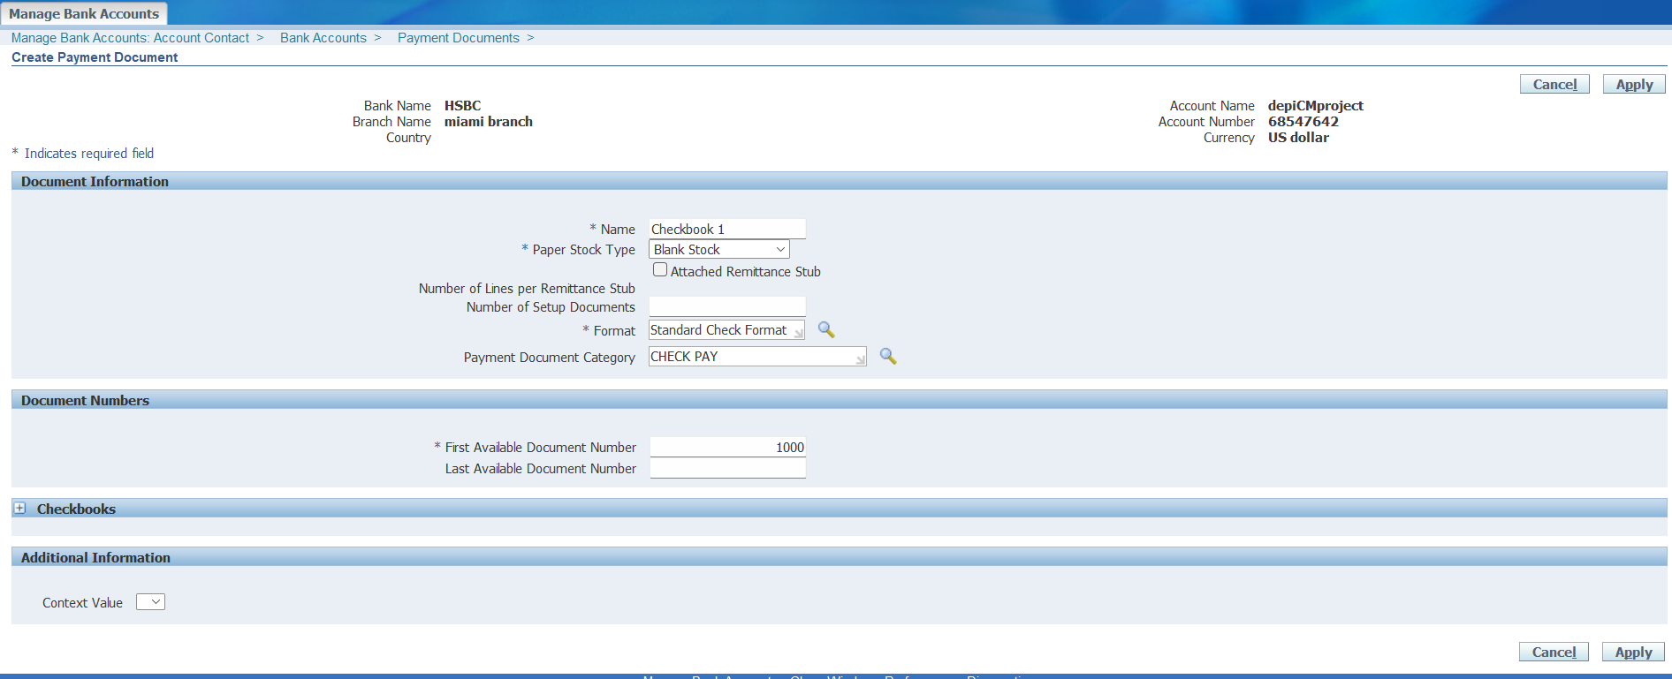
Bank Accounts Creation

Slide 43
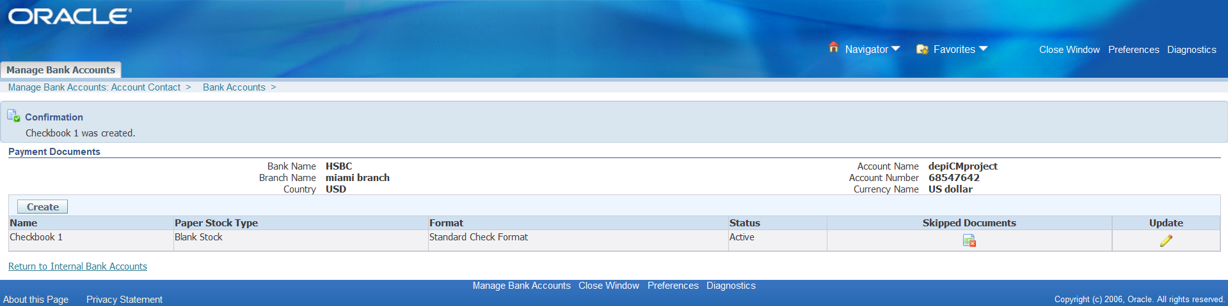
Bank Accounts Creation

Slide 44

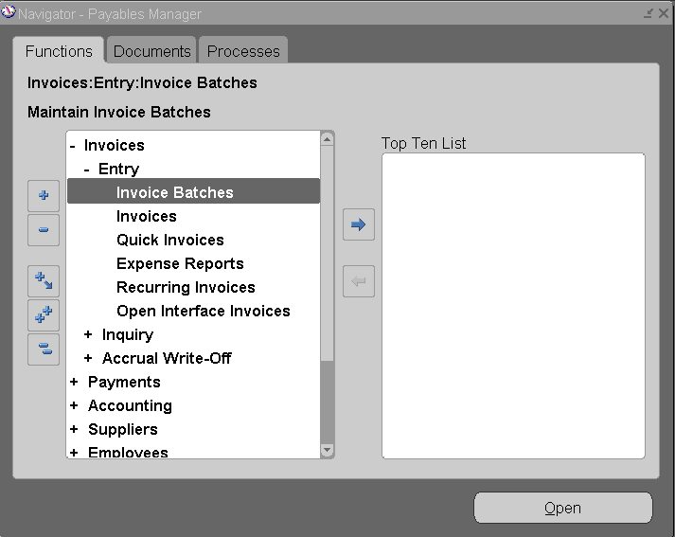
Payables
Here we create an Invoice to show the outflow of cash

Slide 45
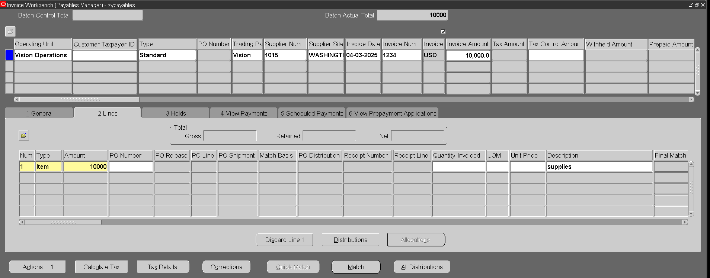
Payables

Slide 46
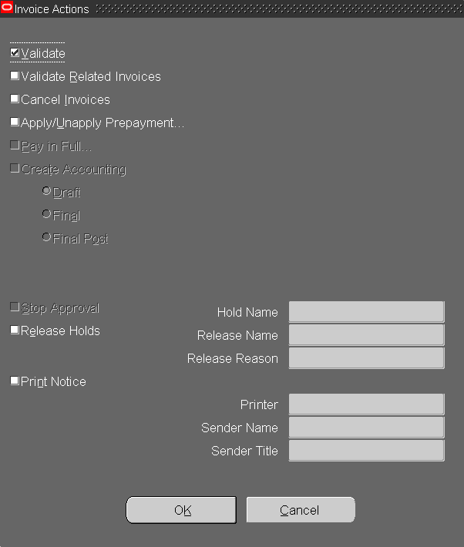
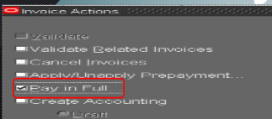
Payables
We first validate the invoice then pay in full

Slide 47
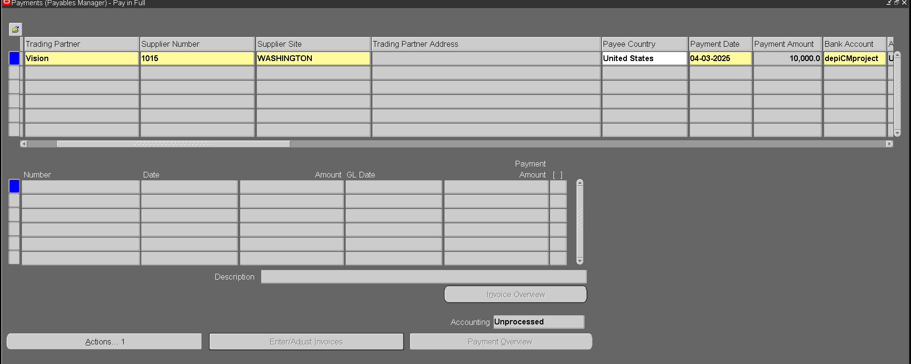
Payables
We now pay the invoice using our Bank account

Slide 48
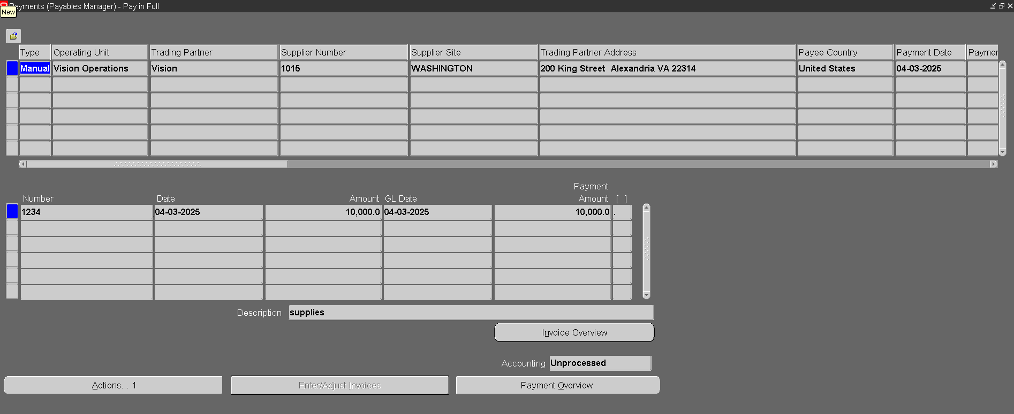
Payables

Slide 49
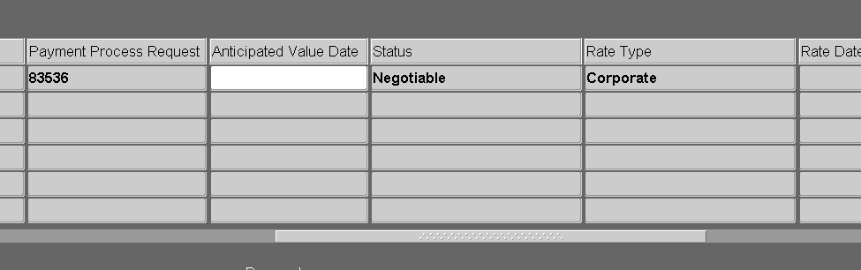
Payables
Now the status has become negotiable

Slide 50
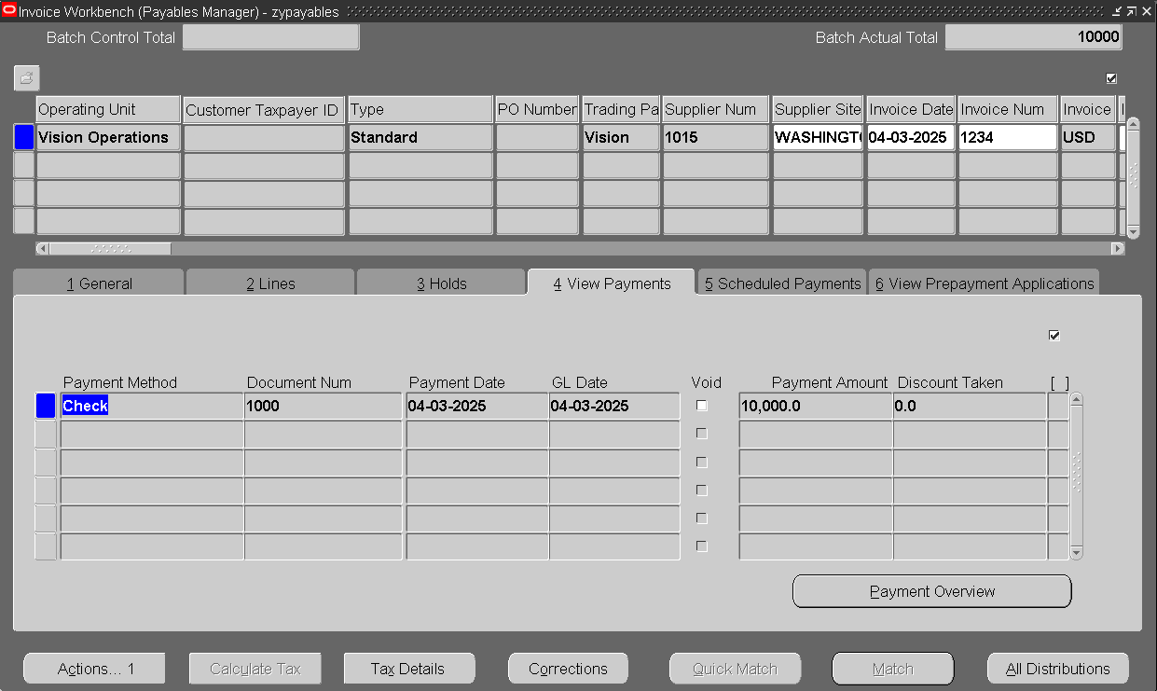
Payables

Slide 51

Payables

Slide 52

Payables
Lastly, We do a "create accounting" request

Slide 53


Payables

Slide 54

Receivables
Now we do the opposite where we create a receipt to show the inflow of cash

Slide 55

Receivables

Slide 56

Receivables

Slide 57

Receivables

Slide 58


Receivables

Slide 59

Receivables

Slide 60

Receivables

Slide 61

Receivables

Slide 62


Receivables

Slide 63


Reconciliation
Now we reconcile all the transactions made in AP & AR modules

Slide 64


Reconciliation
We fill in the bank details and the month we want to reconcile

Slide 65


Reconciliation
We have found some transactions we have made during that month, now we go reconcile them

Slide 66



Reconciliation
After we finish our reconciliation, we go back To AR module and we will find that the status of the transaction has been changed from remitted to Cleared, and that indicates that the reconciliation has been successful
Then finally we do create accounting

Slide 67

Coding
Now we do transaction coding which is important because it will give a code number to different transaction types and link them to the account which we want the transactions to affect
And it is very helpful to accountants to use the codes to make their workflow easier

Slide 68


Coding
We start by coding misc receipts and payment​

Slide 69

Coding
Now we bind the code to the account number, for that we go to cashflow mapping

Slide 70

Coding
We enter the code for both misc transaction types

Slide 71


Coding
We enter the bank details that we want the transaction to affect
Then we open lines

Slide 72

Coding
Then we add 2 lines where we receive a misc payment & receipt

Slide 73

Coding
Now we do multiple requests
1-cashflow creation
2-create accounting
3-transfer to GL

Slide 74

Coding
Open parameters

Slide 75


Coding
Add bank details

Slide 76


Coding
Now we do a create accounting request
Open parameters , make mode final and transfer to GL

Slide 77

Coding
Then we click submit

Slide 78


Coding
Lastly, we run the Transfer to GL request
Submit then check the completion status

Slide 79





Coding
We go open GL and see if our misc. payment has been moved to GL

Slide 80




Coding
We see that both misc transactions are inside this batch
After that we can post the misc receipt and misc payment to GL

Slide 81

Cash Forecasting Report
Cash forecasting is one of the cash management tools we use to predict future cash inflows and outflows. It helps management make decisions by providing a clear view of the company's expected cash position.
Here we will start
1- Cash forecasting to create forecast template.

Slide 82

Cash Forecasting Report
Here we will create the forecast template
1- Header details
Input Template name
Description
Forecast by
Then Next

Slide 83

Cash Forecasting Report
2- Row details
In this step, we will choose the rows related to cash outflows
- Supplier Invoices then Go

Slide 84

Cash Forecasting Report
when we open the supplier invoice details, we will input
Row Number
Description
Operation Unit
Ledger
then Apply

Slide 85

Cash Forecasting Report
Here, we have created the first row in cash inflows

Slide 86

Cash Forecasting Report
Next row is Purchase Orders. We’ll select it and Go

Slide 87

Cash Forecasting Report
when we open the Purchase Orders details, we will input
Row Number
Description
Operation Unit
Ledger
then Apply

Slide 88

Cash Forecasting Report
Here, we’ve added two rows.
Next is Supplier payments we’ll select it and go

Slide 89

Cash Forecasting Report
when we open the supplier payments details, we will input
Row Number
Description
Operation Unit
Ledger
then Apply

Slide 90

Cash Forecasting Report
Here, we’ve added three rows (cash inflows).
Then, we’ll start by selecting the first row in the cash outflows, which is Sales Orders

Slide 91

Cash Forecasting Report
when we open the Sales Orders
details, we will input
Row Number
Description
Operation Unit
Ledger
then Apply

Slide 92

Cash Forecasting Report
Here, we’ve added four rows.
Next is Customer Invoices we’ll select it and go

Slide 93

Cash Forecasting Report
when we open the Customer Invoices details, we will input
Row Number
Description
Operation Unit
Ledger
then Apply

Slide 94

Cash Forecasting Report
Here, we’ve added five rows.
Last row is Customer Invoices we’ll select it and go

Slide 95

Cash Forecasting Report
when we open the Customer Receipts details, we will input
Row Number
Description
Operation Unit
Ledger
then Apply

Slide 96

Cash Forecasting Report
Here, we’ve added six rows:
cash inflows and cash outflows

Slide 97

Cash Forecasting Report
Here we will add the column details for the periods
Then select finish

Slide 98

Cash Forecasting Report
Here the forecast templates has been created
Then we will search with template name to go to next step which run forecast

Slide 99

Cash Forecasting Report
Then select run forecast

Slide 100

Cash Forecasting Report
when we open run forecast details, we will input
Forecast name
Calendar name
Currency
Exchange type
Template name
Factor
Start period
Exchange date
then submit

Slide 101

Cash Forecasting Report
Here, the forecast templates have been run

Slide 102

Cash Forecasting Report
Here, we will go to forecasts
and check the forecast

Slide 103

Cash Forecasting Report
Next, we will go to check requests for cash forecast report

Slide 104

Cash Forecasting Report
Finally, we will have the report that we created and ran for the cash forecasting, including cash inflows and cash outflows.

Slide 105
Thank you

